Slide 1
Measuring the Incremental Effect
of Digital Advertising
A Causal Inference & Uplift Modelling Approach
David Abu | ECON 5140 — Applied Econometrics | April 2026
Dataset: Criteo Uplift v2.1 | 200,000 users | Methods: Diff-in-means · IPW · S-Learner · T-Learner · LightGBM
Notes:
"Today I'm presenting a causal inference project on digital advertising using the Criteo Uplift dataset. The central question is not just whether ads work, but who they actually work for — and who they actively hurt. I'll walk you through the full analytical pipeline from average treatment effects to individual-level targeting recommendations."

Slide 2
Agenda
01
The Marketing Problem
Why uplift modelling — the four user types
02
Dataset & Experimental Design
Criteo Uplift v2.1 — 13.9M users, RCT design
03
Average Treatment Effect
GITHUB : ECONS_5140/AD ANALYSIS.ipynb at main · David-abu/ECONS_5140
Does the ad work on average? (Steps 3 & 4)
04
CATE Estimation
Who benefits most? S-Learner, T-Learner, LightGBM
05
Customer Segmentation
Persuadables, Sure Things, Lost Causes, Sleeping Dogs
06
Uplift Curve Evaluation
Qini coefficient & targeting efficiency
07
Business Recommendations
Actionable targeting strategy

Slide 3
Why Uplift Modelling? The Core Marketing Problem
Traditional targeting asks: who will buy? Uplift modelling asks: whose behaviour CHANGES because of the ad?
PERSUADABLES
SURE THINGS
LOST CAUSES
SLEEPING DOGS
Buy only if shown ad
Buy regardless of ad
Never buy regardless
Ad REDUCES purchase
CATE:
+CATE
CATE:
≈0 CATE
CATE:
≈0 CATE
CATE:
−CATE
Uplift = P(buy|ad) − P(buy|no ad)
Uplift = P(buy|ad) − P(buy|no ad)
Uplift = P(buy|ad) − P(buy|no ad)
Uplift = P(buy|ad) − P(buy|no ad)
TARGET THESE
SKIP — waste budget
SKIP — can't help
AVOID — causes harm
RQ1: What is the average causal effect of the ad? | RQ2: Which users benefit most — and who should we avoid?
Notes:
"The core problem with traditional ad targeting is that it asks the wrong question. It asks who is likely to buy — but that catches people who would have bought anyway, wasting your budget. Uplift modelling asks a smarter question: whose behaviour actually changes because of the ad? There are four types of users. Persuadables are who we want — they buy only because of the ad. Sure Things buy regardless, so the ad is wasted on them. Lost Causes won't buy either way. And Sleeping Dogs are the most dangerous — showing them an ad actually reduces their chance of buying. Our entire project is designed to find the Persuadables and avoid the Sleeping Dogs."

Slide 4
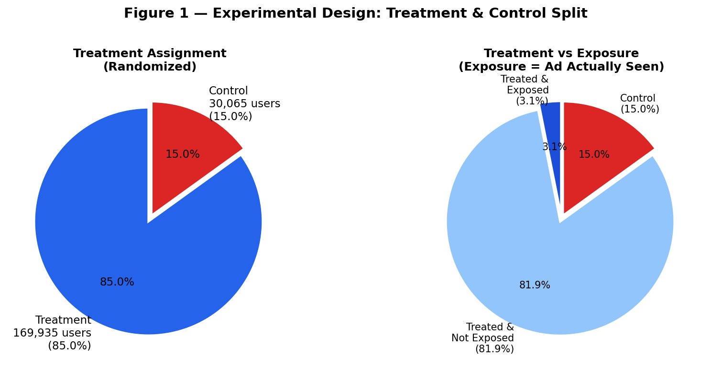
Dataset & Experimental Design
DATA
13.9M
200K
85/15
0.51
Total users
(full dataset)
Sample used
(seed=42)
Treat/Control
split
Propensity AUC
(≈ random — confirms RCT)
Variable | Description
treatment | 1 = ad auction entered; 0 = control (held out)
exposure | 1 = user actually saw the ad
visit | 1 = visited retailer site ← PRIMARY OUTCOME (4.85%)
conversion | 1 = made a purchase ← SECONDARY OUTCOME (0.29%)
f0 – f11 | 12 anonymous float features (anonymised for privacy)
Fig 1 — 85% treated / 15% control (randomised)
Notes:
"We are using the Criteo Uplift v2.1 dataset — a large-scale randomised controlled trial run by Criteo AI Lab. 13.9 million users were randomly split: 85% could receive ads, 15% were deliberately held back as a control group. Because the split is random, any difference in outcomes between the two groups is causally caused by the ad — not by any pre-existing difference between users. We sampled 200,000 rows for this analysis. The propensity AUC of 0.51 — barely above random — confirms the randomisation is clean. The 12 features are anonymised floats. Our primary outcome is website visits at 4.85%."

Slide 5
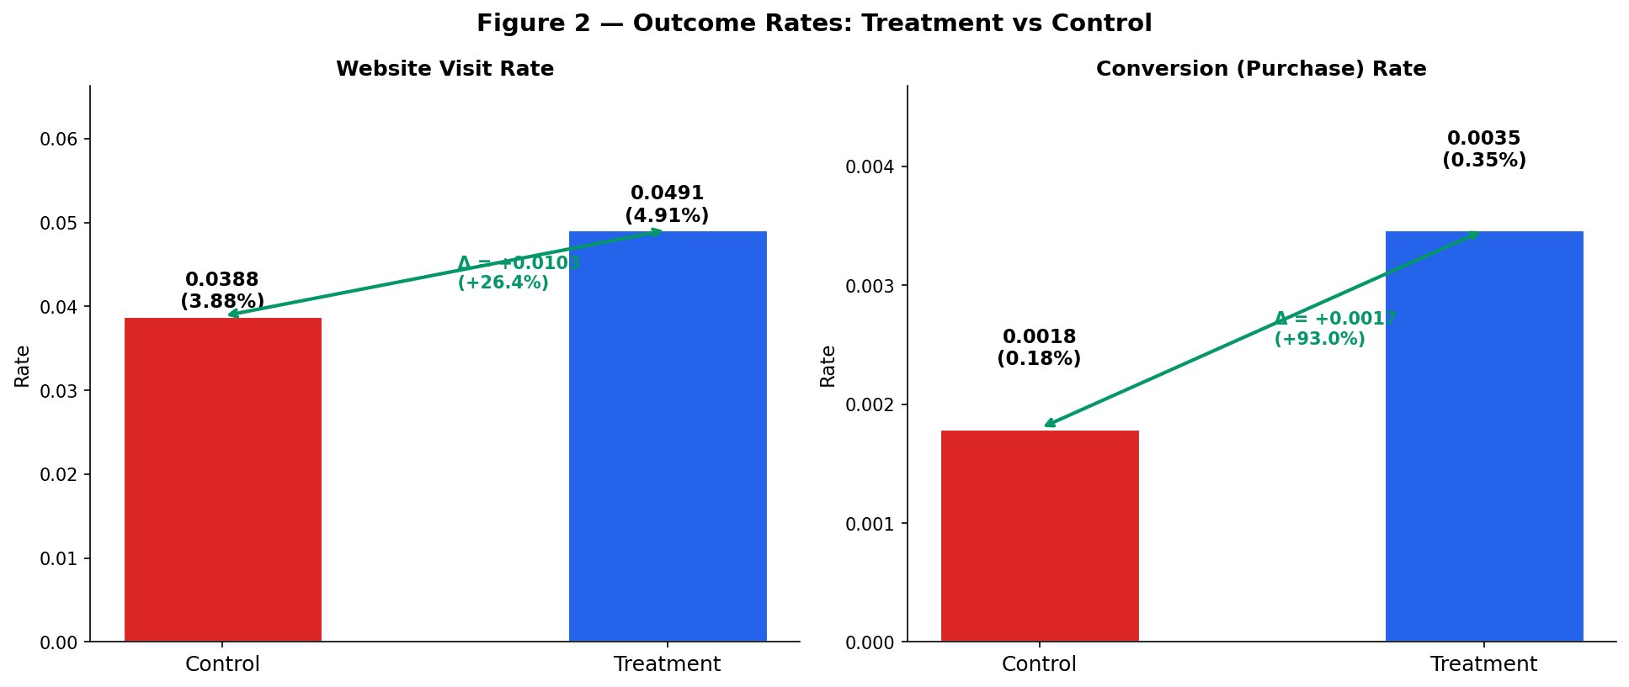
First Evidence: The Ad Works
EDA
Figure 2 — Visit rate: 3.88% (control) vs 4.91% (treatment) = +26.4% lift | Conversion: 0.18% vs 0.35% = +93.0% lift
Notes:
"Before running any formal tests, Figure 2 gives us the first visual signal. The control group visits the site at 3.88%. The treatment group visits at 4.91%. That gap is a +26.4% relative lift. For conversions, the control rate is 0.18% and the treatment rate is 0.35% — nearly double, a +93% relative lift. These are the raw numbers before any statistical testing — and they already look promising."

Slide 6
Average Treatment Effect — Formal Statistical Test
ATE
Because this is a randomised experiment, simple difference-in-means IS our causal estimate.
+0.0103
7.71
p < 0.001
+0.0017
p < 0.001
ATE — Visits
t-statistic
p-value
ATE — Conversions
p-value
Relative Lift on Visits: +26.4%
Relative Lift on Conversions: +93.0%
95% CI Visits [+0.0079, +0.0127] • 95% CI Conversions [+0.0011, +0.0022] • Both exclude zero entirely
IPW Robustness Check: Reweighted ATE = +0.0080 (visits) and +0.0015 (conversions) — same direction, confirmed robust
H₀: ATE = 0 → REJECTED at p < 0.001 for both outcomes
Notes:
"Now we formalise it. The Average Treatment Effect on visits is +0.0103 — meaning the ad increases a user's visit probability by just over one percentage point on average. The t-statistic is 7.71 and the p-value is effectively zero, so we reject the null hypothesis that the ad has no effect. The 95% confidence interval is entirely above zero, which means we are 95% confident the true effect is positive. For conversions, the ATE is +0.0017 — also significant. We also ran a completely independent check using Inverse Probability Weighting, which reweights users by how surprising their treatment assignment was. It reaches the same conclusion. Two methods, same answer — the ad works."

Slide 7
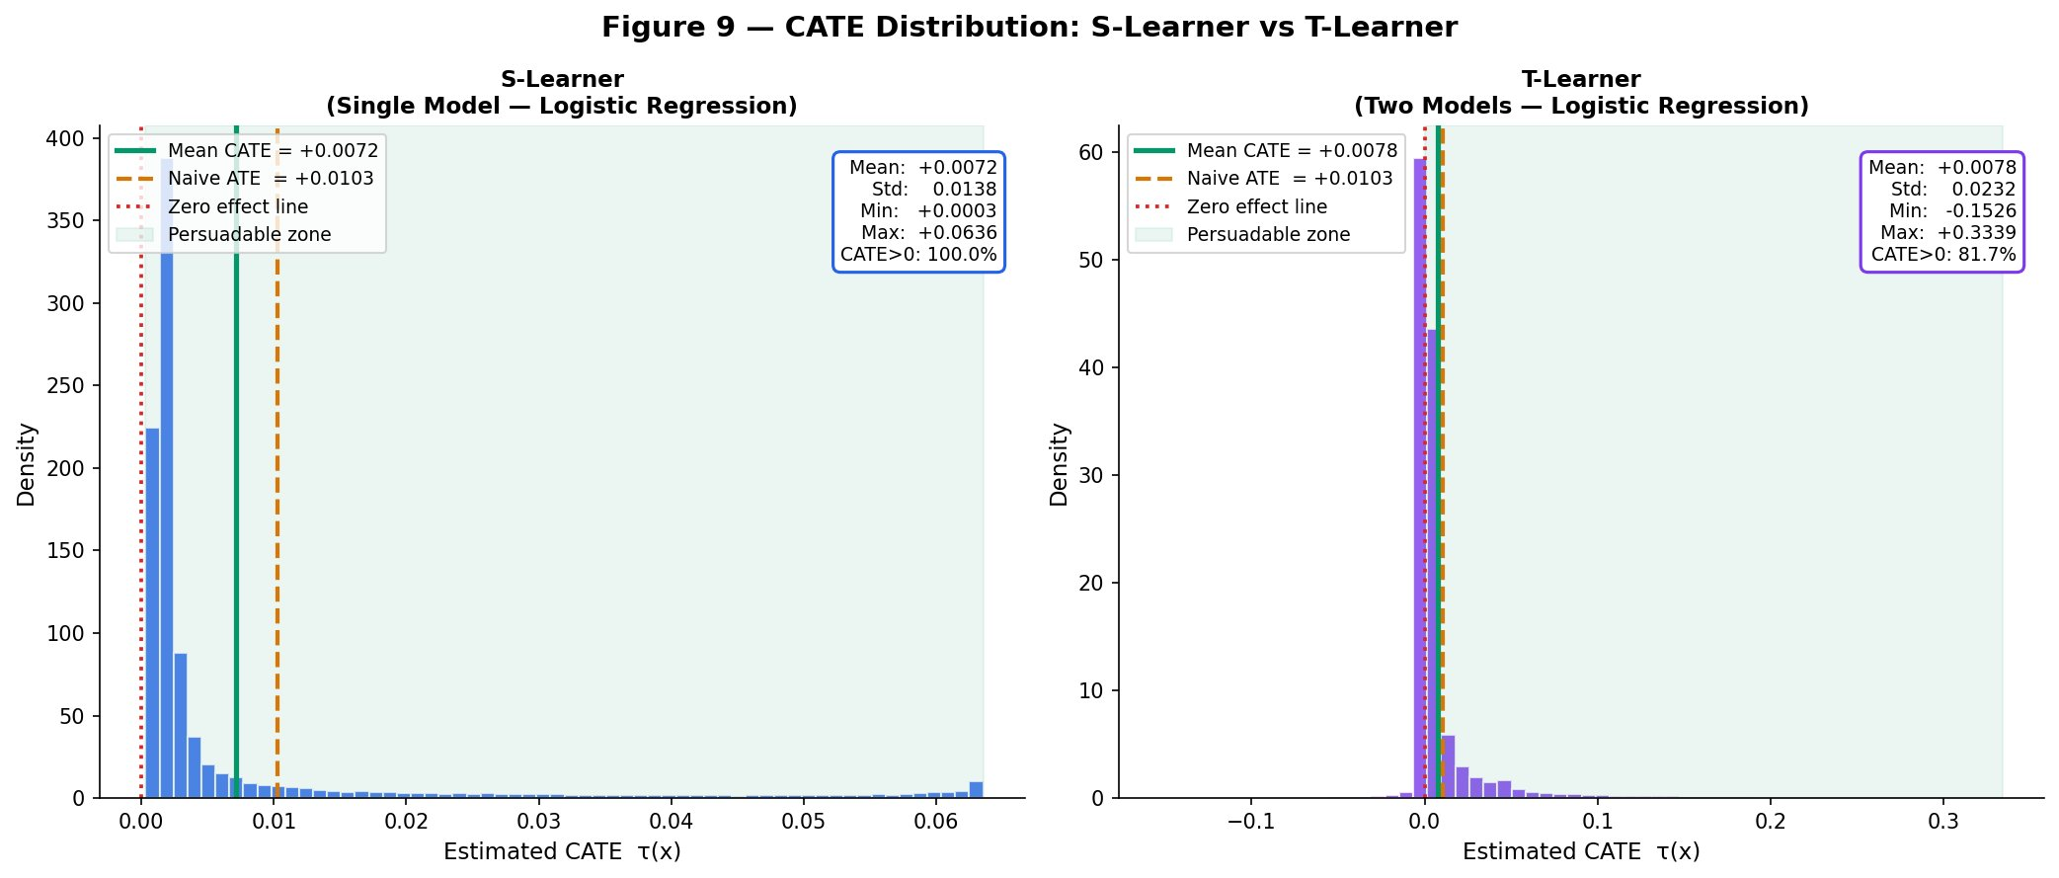
CATE: Personalised Treatment Effects — Who Benefits Most?
CATE
ATE = one number for everyone. CATE gives each user their own estimated treatment effect: τ(x) = E[Y(1) − Y(0) | X = x]
Method | Mean CATE | Range | Persuadables
S-Learner (LR) | +0.0072 | +0.0003 to +0.0636 | 100% (over-inflated)
T-Learner (LR) | +0.0078 | −0.1526 to +0.3339 | 81.7%
T-Learner (LightGBM) | +0.0077 | −0.2724 to +0.5816 | 21.1% ← most realistic
0.944
0.934
LightGBM mu1 AUC
(treated model)
LightGBM mu0 AUC
(control model)
LightGBM: mean CATE unchanged (+0.0077) but reveals 2× wider heterogeneity than LR
Fig 9 — S-Learner (all positive) vs T-Learner (wide spread, finds negatives)
Notes:
"But the ATE is just an average — and averages hide the real story. CATE, the Conditional Average Treatment Effect, gives every user their own personalised estimated treatment effect based on their features. We ran three models. The S-Learner uses one model and is conservative — it finds all effects are positive, which we know is over-simplified. The T-Learner uses two separate models and starts finding negative effects. The LightGBM T-Learner is our most powerful model — it uses gradient boosting to capture non-linear patterns the linear models miss. It achieves outcome model AUCs of 0.94, and finds individual effects ranging from negative 27 percentage points to positive 58 percentage points. The average CATE is identical across all models — the difference is in the spread, which tells us how much heterogeneity is really out there."

Slide 8
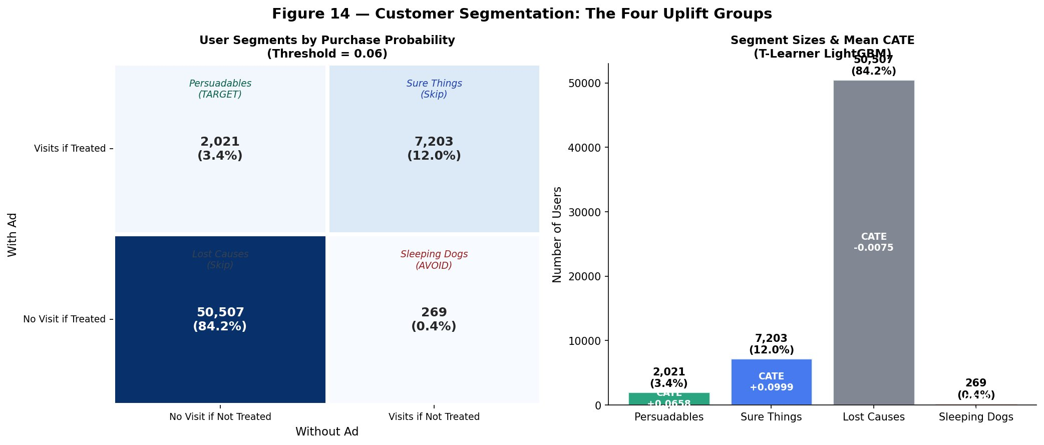
Customer Segmentation: The Four Uplift Groups
SEG
Using LightGBM predicted probabilities (threshold = 0.06) to classify all 60,000 test users into 4 actionable segments.
PERSUADABLES
TARGET THESE
2,021 (3.4%)
CATE +0.0658
SURE THINGS
SKIP
7,203 (12.0%)
CATE +0.0999
LOST CAUSES
SKIP
50,507 (84.2%)
CATE −0.0075
Fig 14 — 2×2 segmentation heatmap (LightGBM, threshold = 0.06)
SLEEPING DOGS
SUPPRESS
269 (0.4%)
3.4% | 12% | 84.2% of users | 0.4%
CATE −0.0397
Notes:
Segmentation
"Using the LightGBM predicted probabilities, we classify every test user into one of four segments. The 2x2 heatmap on the left shows who visits with and without the ad. The results on the right are the key business finding. Only 3.4% of users — 2,021 people — are genuine Persuadables. These are the users the ad actually moves. 84.2% are Lost Causes — the ad cannot help them. 12% are Sure Things who convert without any ad. And 0.4% are Sleeping Dogs who we should actively exclude. This means 84 cents of every dollar spent on random targeting is wasted. The entire business case for uplift modelling lives in finding that 3.4%."

Slide 9
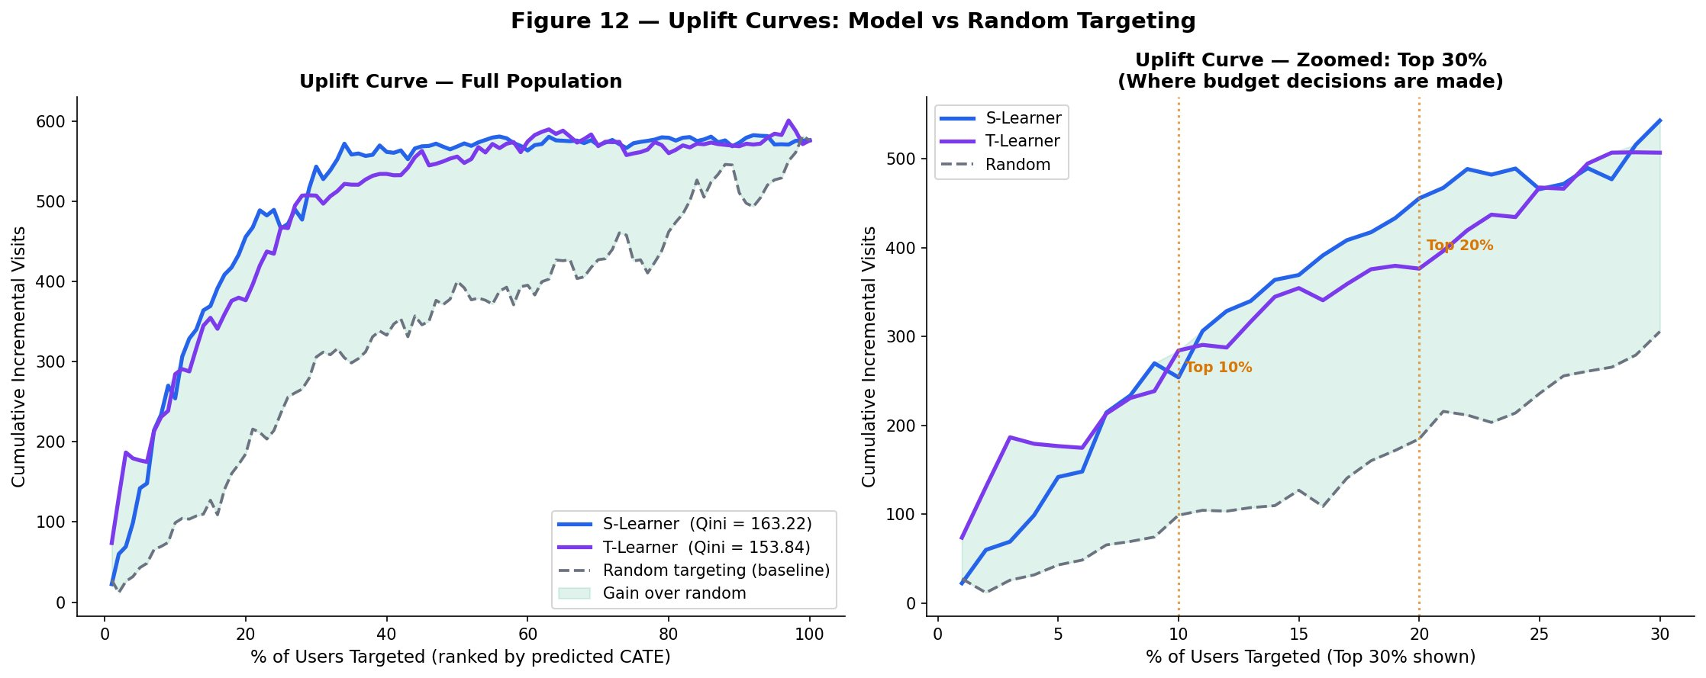
Uplift Curves: Model vs Random Targeting
EVAL
Figure 12 — S-Learner Qini = 163.22 | T-Learner Qini = 153.84 | Random = 0. Both models far above random baseline across all targeting depths.
Notes:
Uplift Curves (Fig 12)
"The uplift curve is how we evaluate whether our models actually help with targeting. We rank all users from highest to lowest predicted CATE, then progressively target more of them and measure cumulative incremental visits. If our model is useless, we'd do no better than random — that's the dashed grey line. Both the S-Learner and T-Learner sit dramatically above the random baseline across the entire population. The Qini coefficient summarises this as a single number — 163 for the S-Learner versus zero for random. That gap is the value our models create."

Slide 10
The Business Case: Targeting Efficiency
EVAL
Ranking users by predicted CATE is 2-3× more efficient than random targeting at every budget depth.
163
79%
65%
2.5×
S-Learner Qini
(best ranker)
Uplift captured
(top 20%, S-Learner)
Uplift captured
(top 20%, T-Learner)
More visits vs random
(top 10%)
Targeting Depth | Random Visits | S-Learner Visits | T-Learner Visits | % Uplift Captured
Top 10% | 99 | 254 | 284 | 44-49%
Top 20% ← SWEET SPOT | 185 | 456 | 377 | 65-79%
Top 30% | 306 | 543 | 507 | ~94%
Top 100% | 576 | 576 | 576 | 100% (all converge)
Notes:
Efficiency Numbers
"This slide translates the uplift curve into concrete business numbers. If you target randomly, contacting 20% of users gives you 185 incremental visits. If you target the top 20% ranked by our model, you get 456 incremental visits — that is 146% more impact from the same number of contacts. Even more striking on the right column — targeting just 20% of users by our model captures 65 to 79% of the entire campaign's possible uplift. You get four fifths of the value by contacting one fifth of the audience. Beyond 30% targeting depth, the marginal gain drops sharply — meaning anything beyond the top 30% is increasingly close to wasted spend."

Slide 11
Business Recommendations: Actionable Targeting Strategy
1
Rank by LightGBM CATE
4
Skip Sure Things (12%)
Score all users before every campaign using T-Learner LightGBM
They buy without ads — redirect that 12% budget to Persuadables
2
Target Top 20-30% only
5
Prioritise f1 & f9 high users
Captures 65-79% of total uplift — contact 1 in 5 users, get 4/5 value
Strongest positive CATE predictors — front-load these in targeting
3
Suppress Sleeping Dogs (0.4%)
6
Retrain models quarterly
Explicit exclusion list — these 269 users respond negatively to ads
User behaviour evolves — refresh LightGBM every 3 months
Notes:
"Based on the full analysis, here are six concrete actions for a marketing team. First, rank all users by LightGBM CATE before every campaign — this is your targeting list. Second, only contact the top 20 to 30% — this is where the value is concentrated. Third, build a suppression list of Sleeping Dogs — these 269 users respond negatively and should never be targeted. Fourth, skip Sure Things entirely — they convert without the ad, so every impression on them is pure waste. Fifth, prioritise users with high values of features f1 and f9, which are the strongest positive predictors of treatment response. Sixth, retrain the models every quarter because user behaviour evolves."

Slide 12
Key Takeaways
1
The ad works — ATE +1.03pp on visits (+26.4%) and +0.17pp on conversions (+93.0%), confirmed by both Naive and IPW estimation.
2
Heterogeneity is real — CATE ranges from −0.27 to +0.58. LightGBM (AUC 0.94) reveals 2× wider spread than Logistic Regression.
3
Only 3.4% are true Persuadables. 84.2% are Lost Causes. Targeting everyone wastes 84 cents of every advertising dollar.
4
Model-based targeting captures 65-79% of total uplift from just 20% of users — 2-3× more efficient than random targeting.
Uplift modelling is not just better prediction — it is causal targeting. Finding the 3.4% is worth more than reaching the other 96.6%.
Thank You | David | ECON 5140 — Applied Econometrics | April 2026 | Dataset: Criteo Uplift v2.1
Notes:
"To close — four things to remember. One: the ad works. ATE of plus 26.4% on visits and plus 93% on conversions, proven by two independent methods. Two: the effect is not uniform — CATE ranges from minus 0.27 to plus 0.58. The average hides enormous variation. Three: only 3.4% of users are true Persuadables. 84.2% are Lost Causes. Random targeting wastes 84 cents of every dollar. Four: by targeting the top 20% by predicted CATE, we capture 65 to 79% of the entire campaign's possible uplift at a fraction of the cost. The headline insight is this — uplift modelling is not just better prediction. It is causal targeting. Finding the 3.4% is worth more than reaching the other 96.6%."

Slide 13
My Project on Github
ECONS_5140/AD ANALYSIS.ipynb at main · David-abu/ECONS_5140

